Slide 1
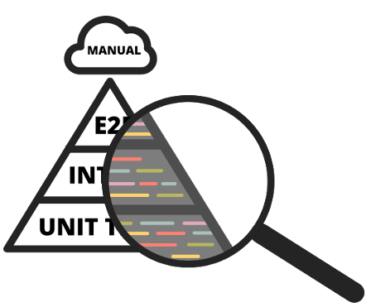
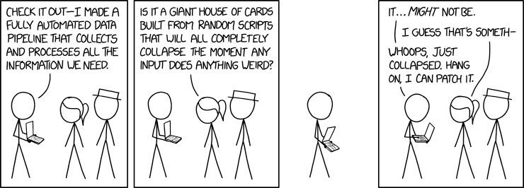
Theodore MANAssis @ONS Testing (A RAP PERSPECTIVE)
Testing
Coverage
What to test?
Manual Testing
Automated testing
Property based testing
Mutation Testing
Continuous Integration (CI)
Package creation

Slide 2
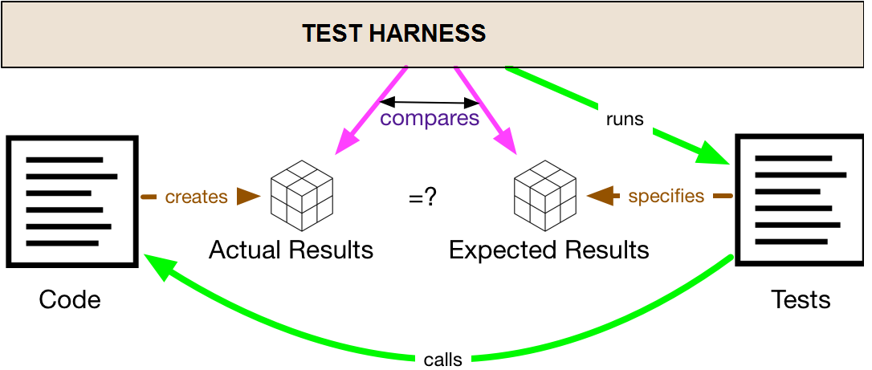
Testing
A program implements functionality, aka behavior.
Tests = supplementary code, that compares the actual behavior (from running the program) to the expected behavior (that’s coded into the test suite).
Your test harness is the framework that finds your tests, runs your tests, and (in theory) helps you write tests.

Slide 3


Testing II
If you hate your test harness, you will never enjoy writing tests. It’ll always be a slog, and you’ll avoid it whenever you can.
pytest is a good package for helping with testing in Python. It minimizes the friction involved in writing tests to as little as possible
testthat package works similarly for R

Slide 4
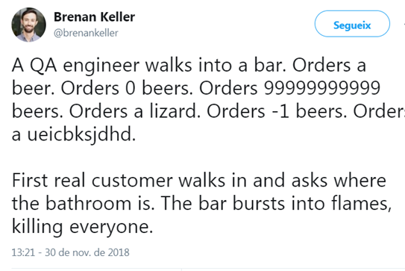
What to test?
- Sanity tests (eg. 1+1==2) . If this doesn’t work nothing will work ☺
- Unit tests (usually testing the result of a specific function)
Usually human-validated cases of function results from known parameters
Edge cases perhaps?
Useful to first create the test (that fails) and then code the function in a correct way so it can pass the test (Test Driven Development)
But this is kind of…AUTO_MANUAL / Anecdote based unit testing

Slide 5
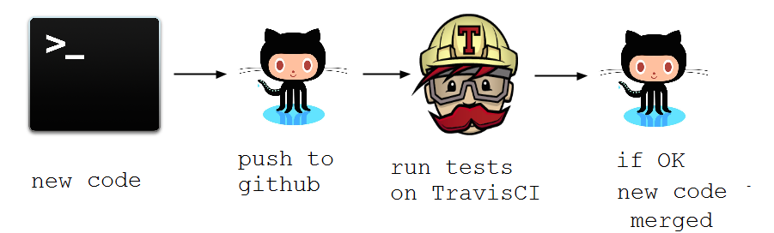
Continuous Integration
Continuous Integration is a software development practice where members of a team integrate their work on a main repo frequently.
Usually each person integrates their work at least daily leading to multiple integrations per day.
Each integration is verified by an automated build (that includes running an automated test harness) to detect integration errors as quickly as possible.
Many teams find that this approach leads to significantly reduced integration problems and allows a team to develop cohesive software more rapidly.

Slide 6
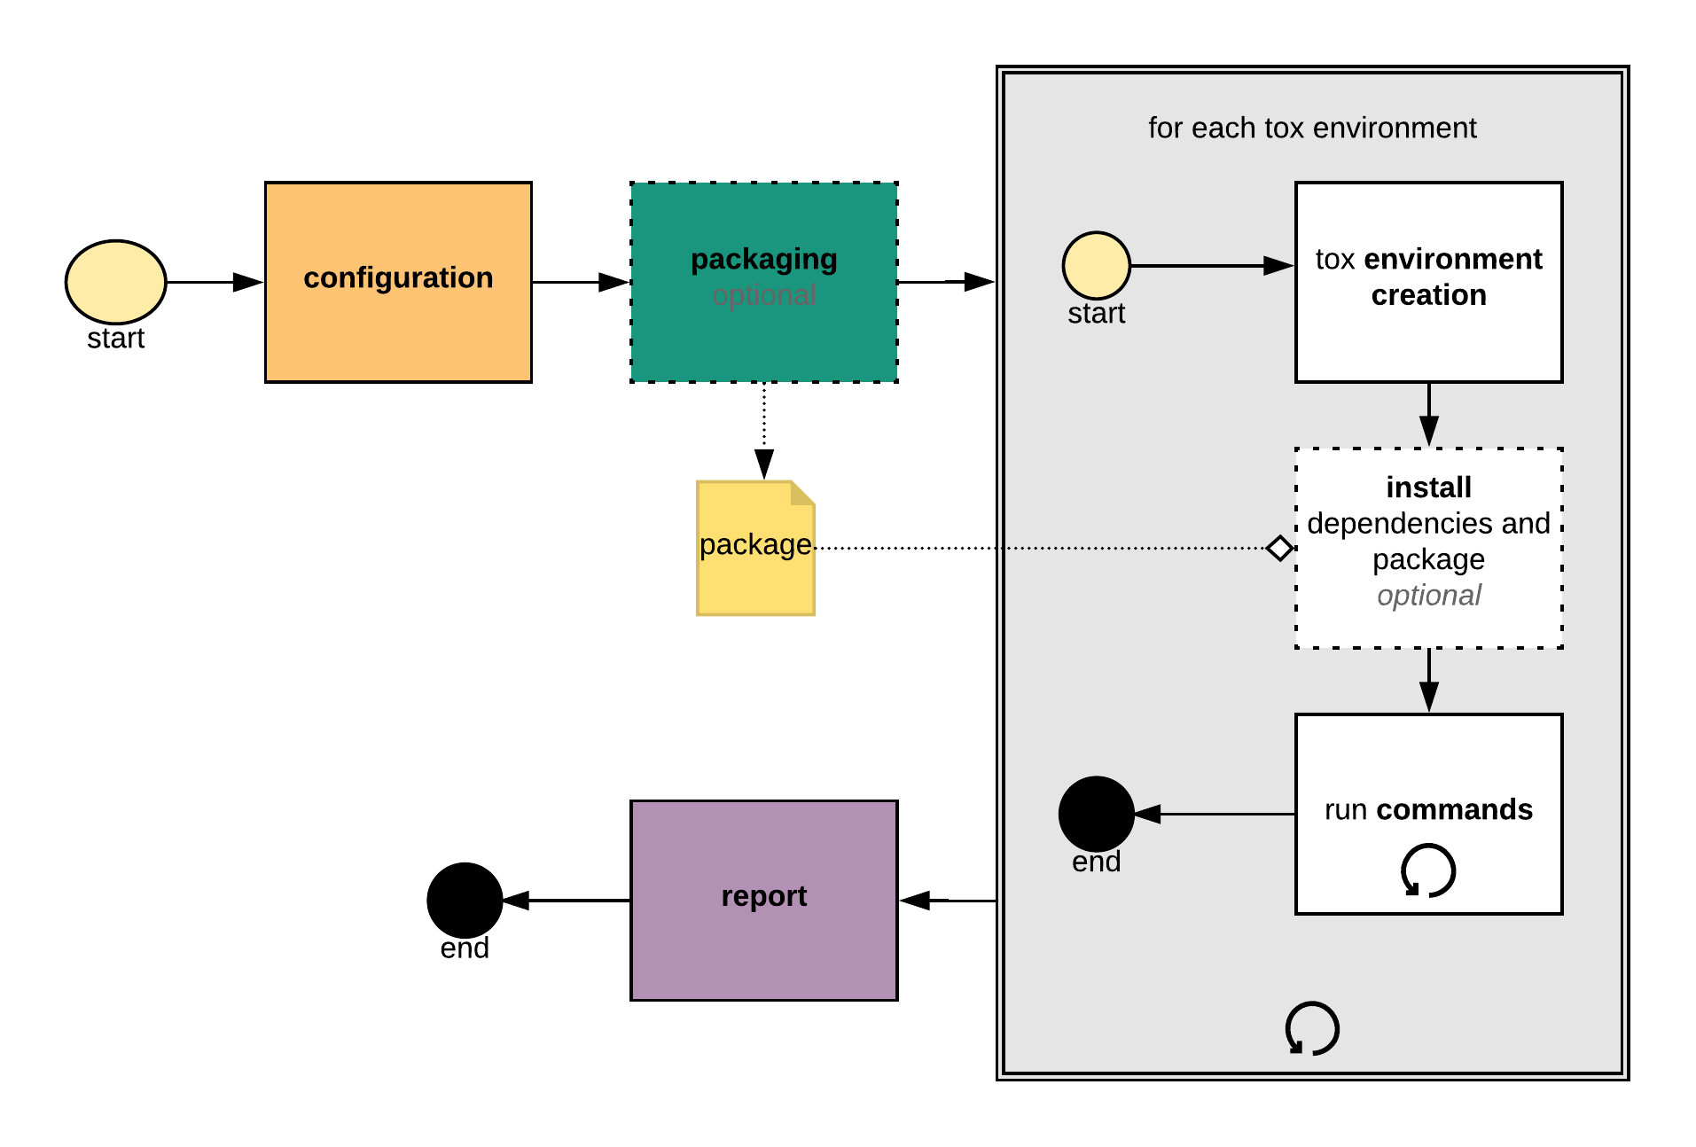
Automatic testing I : environments
- tox / nox for automating environments
ie. Ok it works on my machine but does it work on:
Python 2.7+,3.3,3.4,3.5,3.6 ?
On both Win and Linux Based systems?
Already 10 combinations of envs
Tox/nox automate this for example
envlist={py27,py33,py34,py35,py36}-{windows,linux}

Slide 7
Automatic testing II (basics)
- py.test parameterize / fixtures for unit tests
- Fixture functions can be parametrized in which case they will be called multiple times, each time executing the set of dependent tests
- Test functions usually do not need to be aware of their re-running.
- Fixture parametrization helps to write exhaustive functional tests for components which themselves can be configured in multiple ways

Slide 8
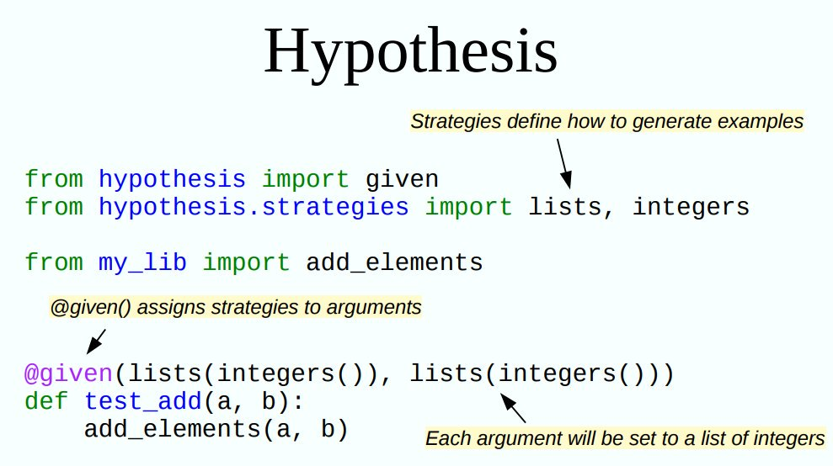
Automatic testing III (PBT) in python
- hypothesis module
Property Based Testing:
Describe the input
Describe the properties of the output
Have the computer try lots of random examples – check they don’t fail
Availiable as a pytest plugin

Slide 9
Automatic testing III (PBT) in R
- hedgehog library

Slide 10
Property based testing (nice to have)
A bit more involved
Writing good properties can be hard
Writing good generators can be even harder
PBTs are more general
One property-based test can replace many example-based tests.
PBTs can reveal overlooked edge cases
Nulls, negative numbers, weird strings, etc.

Slide 11
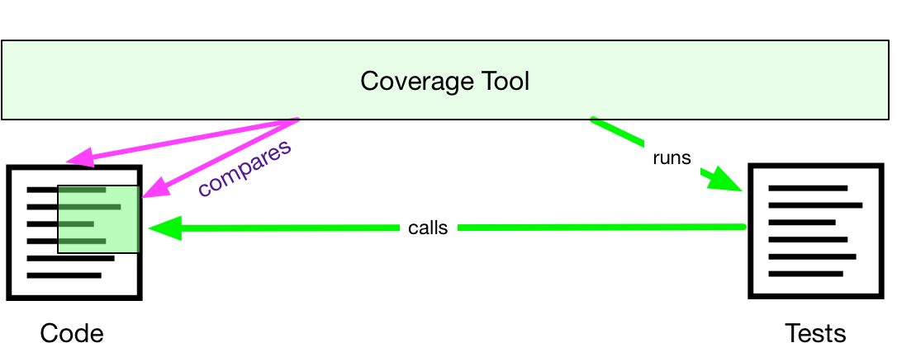
Code/Test Coverage
Some parts of your code end up being tested, some don’t.
Code coverage (or test coverage) is a measure of how much of your code is executed by tests.
A code coverage tool runs your test suite against a logged version of your program, and reports its coverage.
Pytest can get this functionality thru a coverage plugin
You can always setup your coverage tool to ignore certain parts that you don’t want to test.

Slide 12
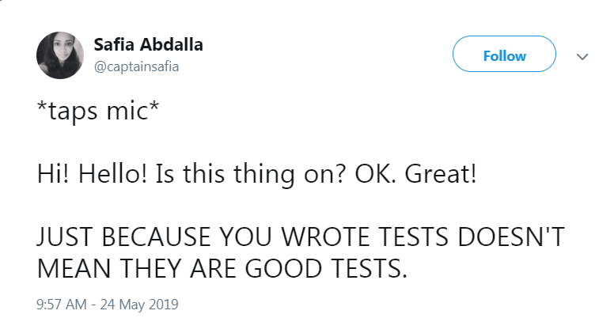
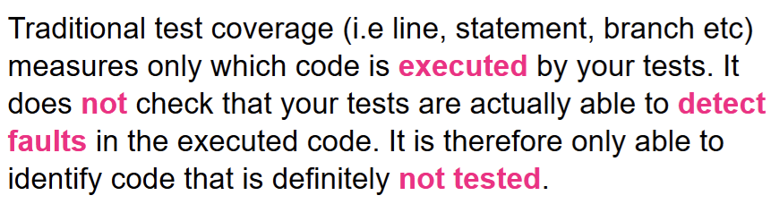
“Covered” doesn’t mean “well tested”

Slide 13

Automatic testing IV: Mutation Testing
Mutation testing involves modifying a program’s source code or byte code in small ways.
A test suite that does not detect and reject the mutated code is considered defective.
These so-called mutations, are based on well-defined mutation operators that either mimic typical programming errors (such as using the wrong operator or variable name) or force the creation of valuable tests (such as driving each expression to zero).
The purpose is to help the tester develop effective tests or locate weaknesses in the test data used for the program or in sections of the code that are seldom or never accessed during execution.
Related Python packages :
mutpy / mutmut / cosmic_ray (recommended)

Slide 14
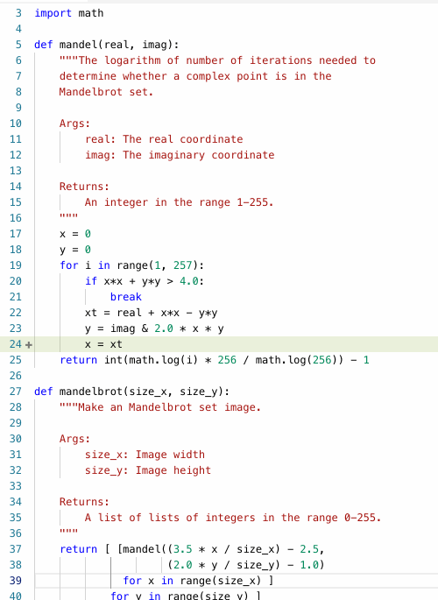
Automatic testing IV: Mutation Testing
Mutation testing involves modifying a program’s source code or byte code in small ways.
A test suite that does not detect and reject the mutated code is considered defective.

Slide 15

Unit testing…the end?

Slide 16
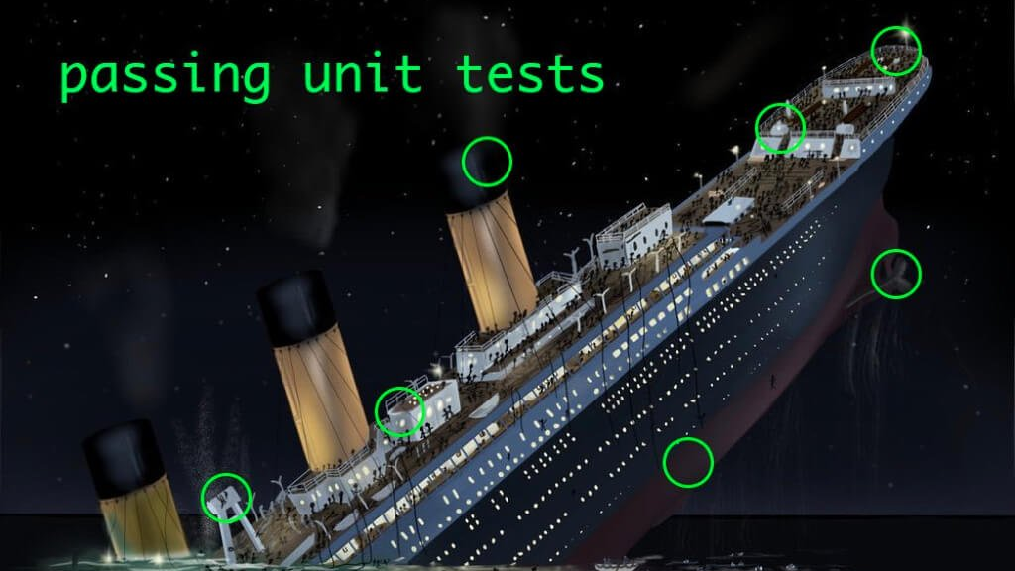

Slide 17
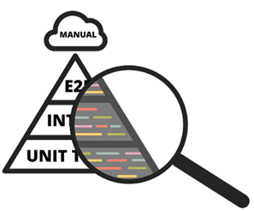
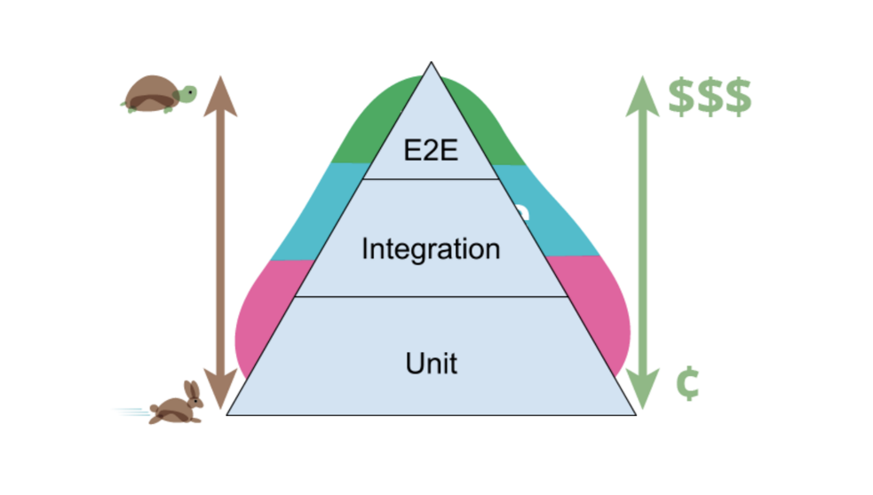
Unit tests are not enough.
Also need integration tests as well to test how different functions / systems work together.
End-to-End tests are useful too.
This kind of testing is very useful for the Reproducible Analytical Pipelines we are trying to help construct.

Slide 18
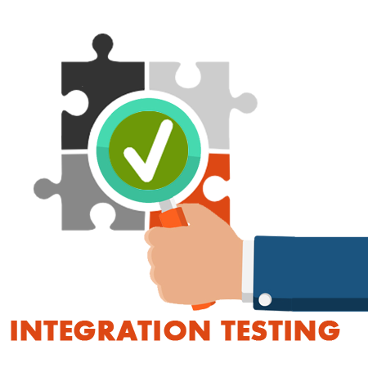

Integration Testing
Integration testing: Testing performed to expose defects in the interfaces and in the interactions between integrated components or systems.
(… systems such as Reproducible Analytical Pipeline steps !!!!)

Slide 19
Integration Testing
Need integration tests across the whole stack,
But fewer,
Only to find integration issues, not subsystem level functionality issues.
Needed after each subsystem has been validated in isolation.
This ensures that integration tests will find integration issues.
There may still be emergent issues when the whole stack is used together * hence E2E testing needed
But if each subsystem has been validated in isolation, then any integration bugs are just that; due to integration, not any of the subsystems.

Slide 20

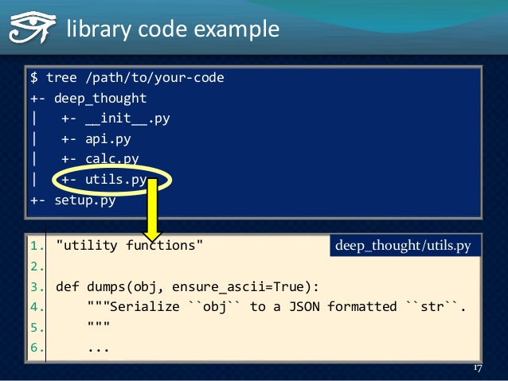
Code Auto-Documentation
SPHINX (autodoc) in Python
Can take docstring comments in function code as input
You can define input parameters and output and include and preferably an example.
Many outputs (HTML/PDF/LaTeX)
Example can be taken from test or test from example

Slide 21
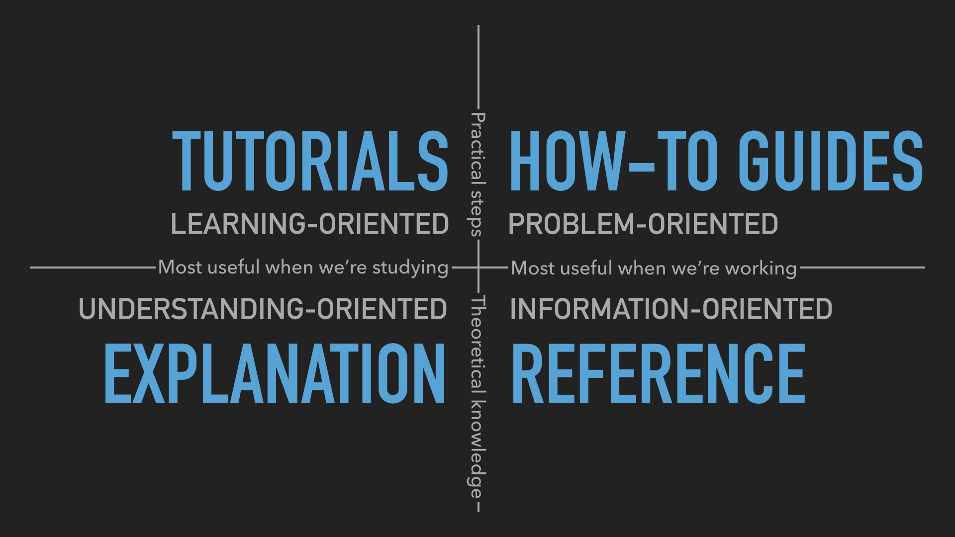
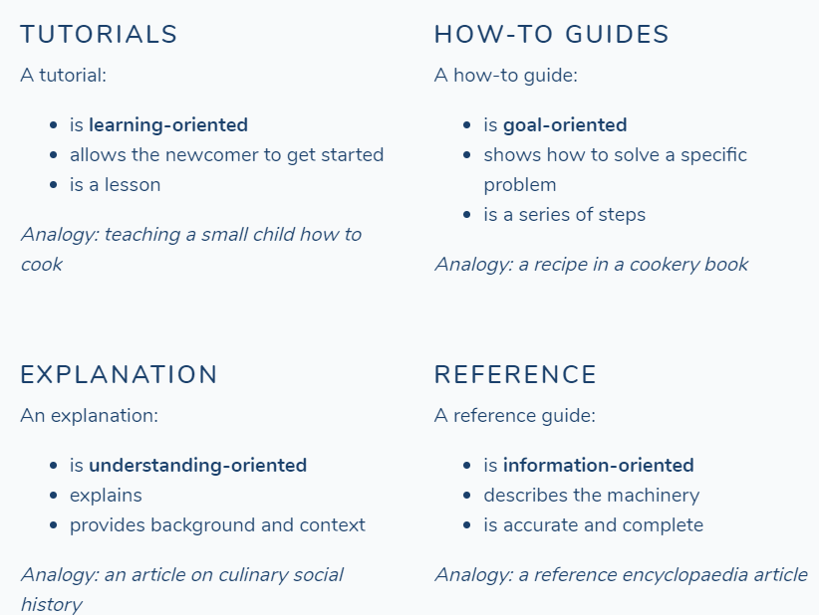
Documentation
Taken from:
https://www.divio.com/blog/documentation/
Please have a look for elucidating the concepts if interested

Slide 22
Continuous Integration

Slide 23
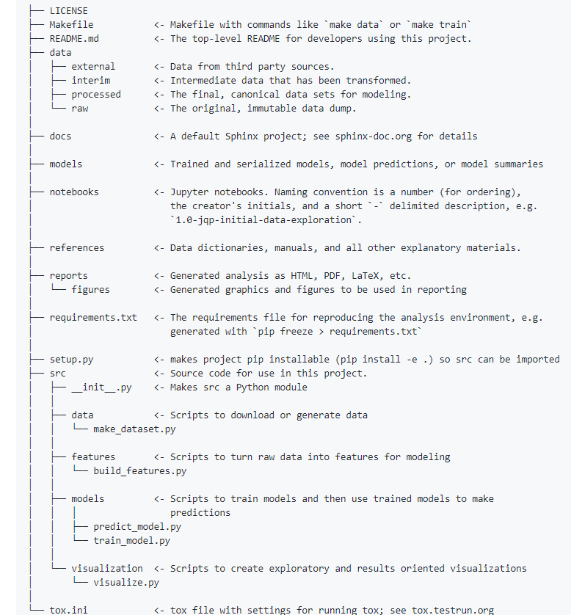
Project organization
Do not reinvent the wheel regarding how you organize the code for your project:
Python: cookiecutter
R:
https://github.com/bdcaf/cookiecutter-r-data-analysis

Slide 24
Current RAP work
Data Access Platform (on premise cloud RedHat/CDH/Spark cluster based environment)
-Many analysts with no experience of command-line.
Distributed processing (bringing its own gremlins!!)
However : outputs perhaps influencing policy so its very important to be 100% outputs are correct.
ONS DAPCATS team is creating material and training
Other Projects
NLPBumblebee: inhouse NLP package created for consolidating usual simpler functions used in NLP in a composable way
Created in order to use certain NLP functionality on admin locked down machines.
https://github.com/mamonu/bumblebee

Slide 25
References and material of interest
- Some Books of interest :
https://certifications.bcs.org/upload/pdf/swt-intermediate-reading.pdf
https://www.oreilly.com/library/view/python-testing-with/9781680502848/
- Blog Posts
https://martinfowler.com/articles/practical-test-pyramid.html
https://hypothesis.works/articles/
https://docs.pytest.org/en/latest/
https://medium.com/homeaway-tech-blog/write-better-python-with-hypothesis-5b31ac268b69
- Course
Great course covering the spectrum of tools from the R side of things:
https://www.udemy.com/reproducible-analytical-pipelines/
- Covered /useful Python modules:
py.test : https://github.com/pytest-dev/pytest
mutpy/mutmut/cosmic_ray
hypothesis : https://github.com/HypothesisWorks/hypothesis
tox / nox : https://github.com/tox-dev/tox
cookiecutter: https://github.com/audreyr/cookiecutter
pyjanitor : https://github.com/ericmjl/pyjanitor
Article : When RAP processes are not there…..
https://www.bbc.co.uk/news/magazine-22223190

Slide 26
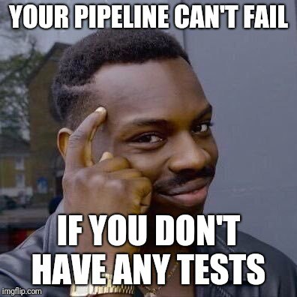
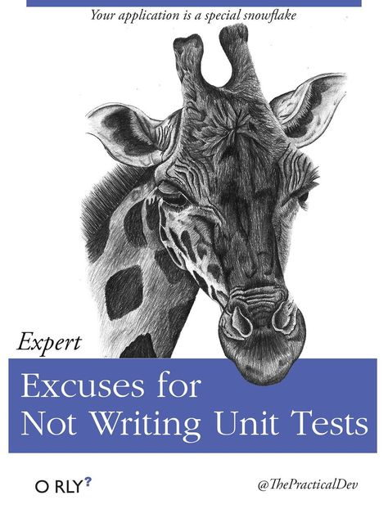


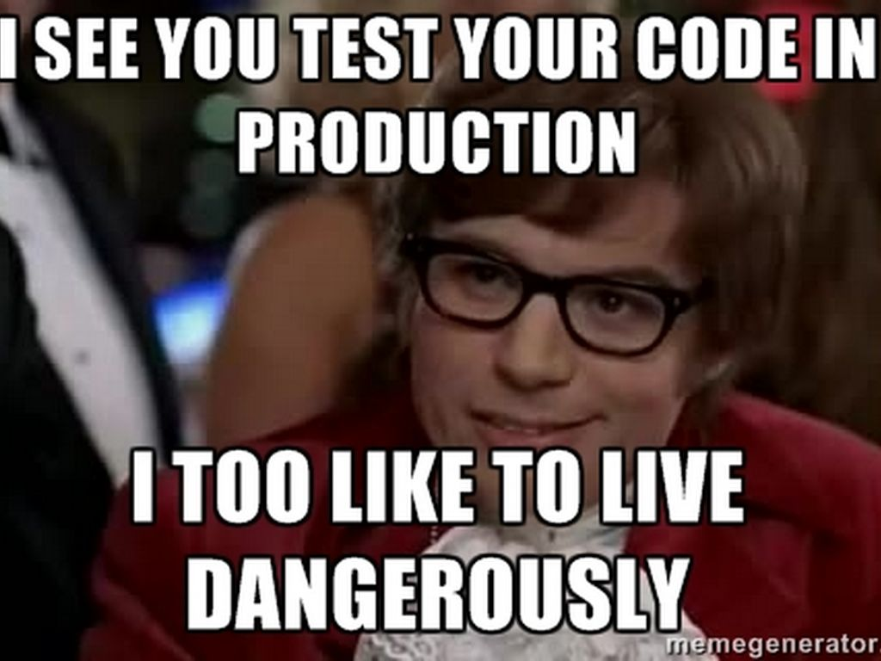
Obligatory MEMES!

